Slide 1
Regularization and Model Selection

Slide 2
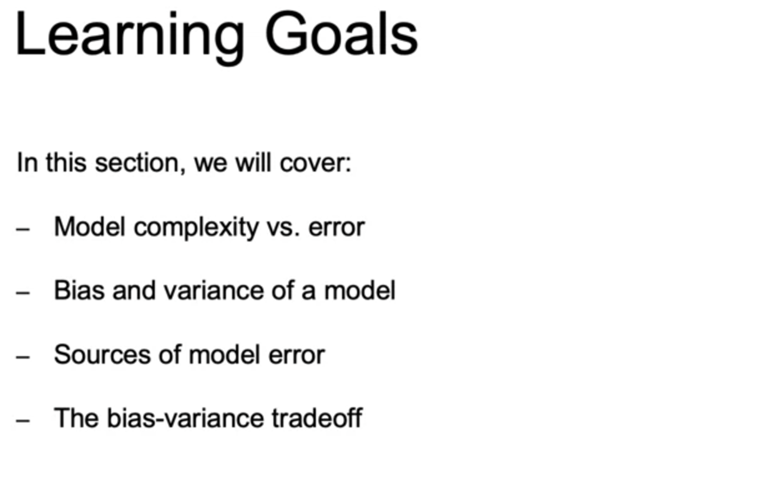
Bias Variance Trade off

Slide 3
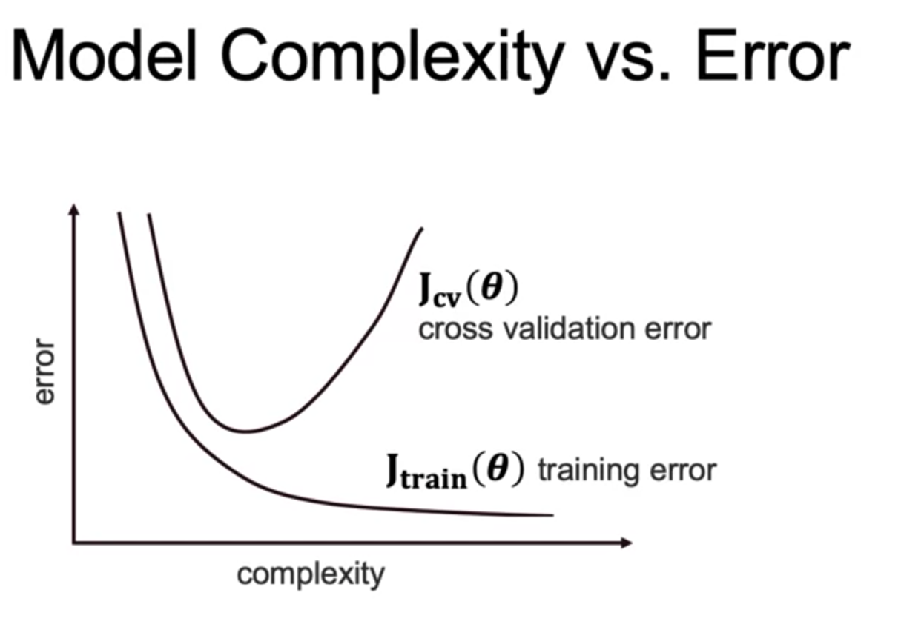
Bias Variance Trade off

Slide 4
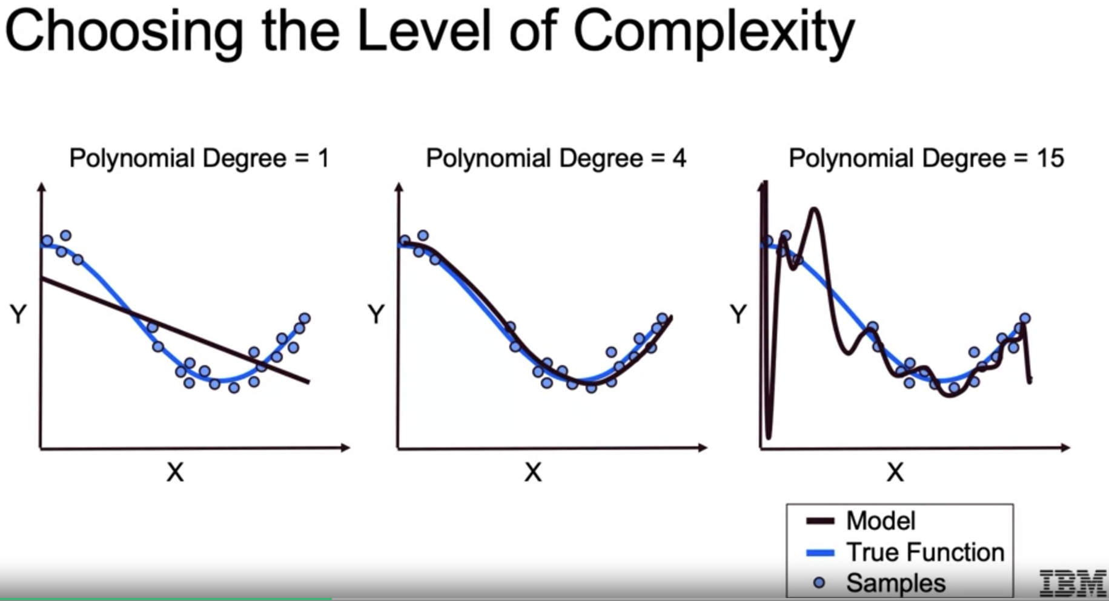
Bias Variance Trade off

Slide 5
Bias Variance Trade off

Slide 6
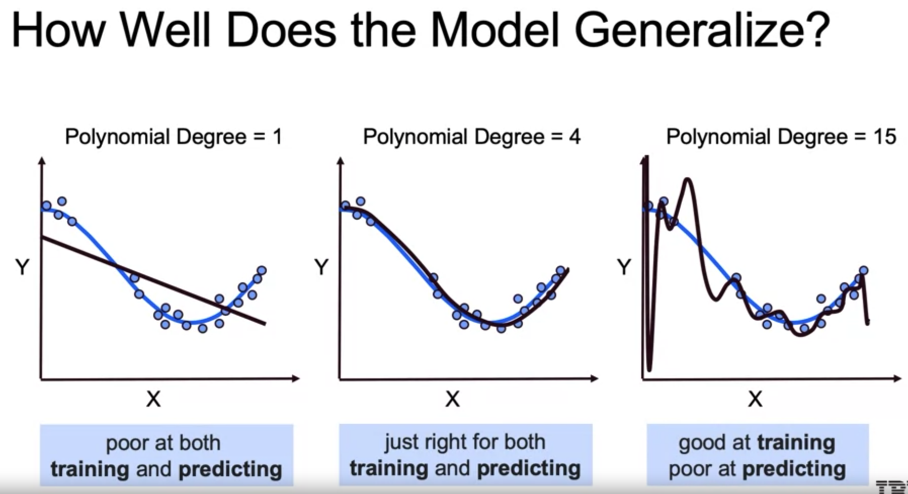
Bias Variance Trade off

Slide 7
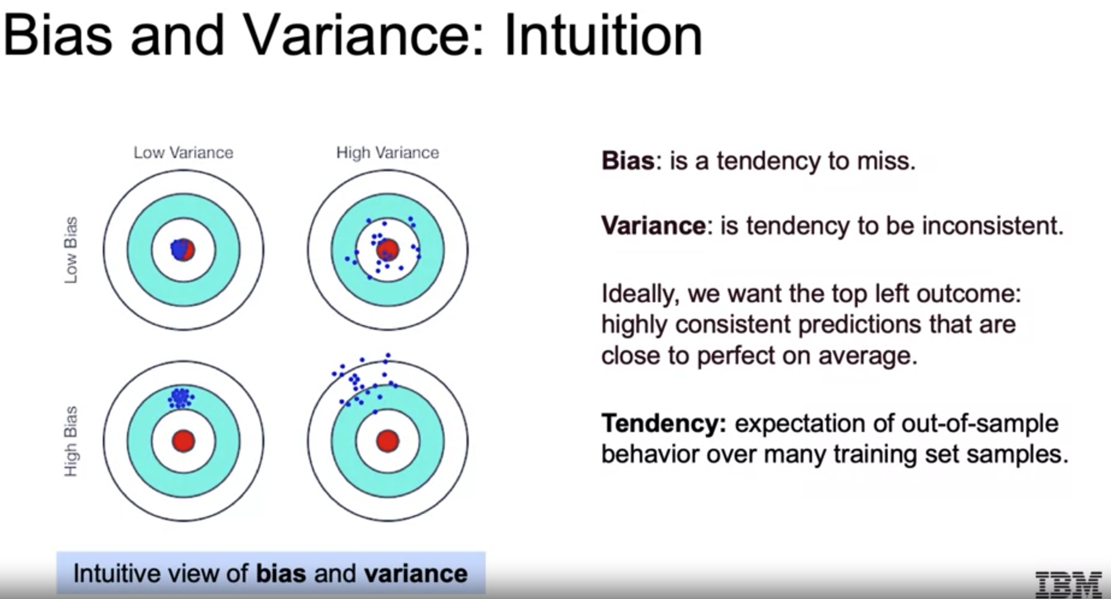
Bias Variance Trade off

Slide 8
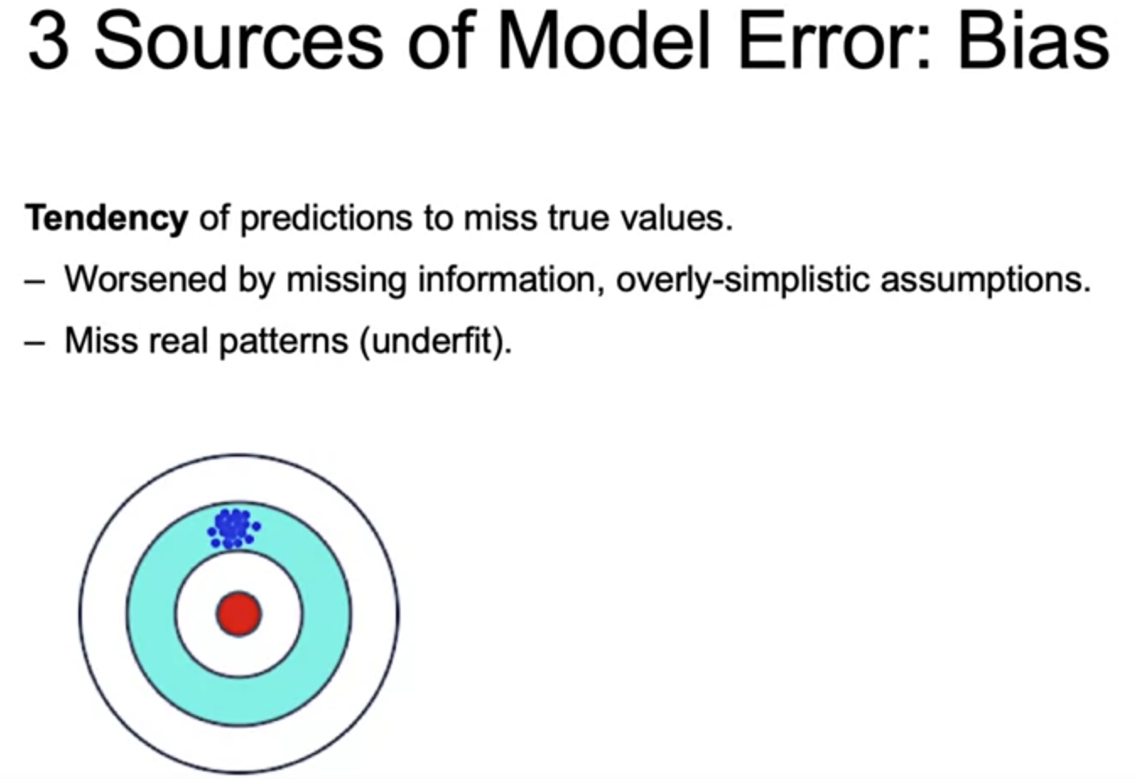
Bias Variance Trade off

Slide 9
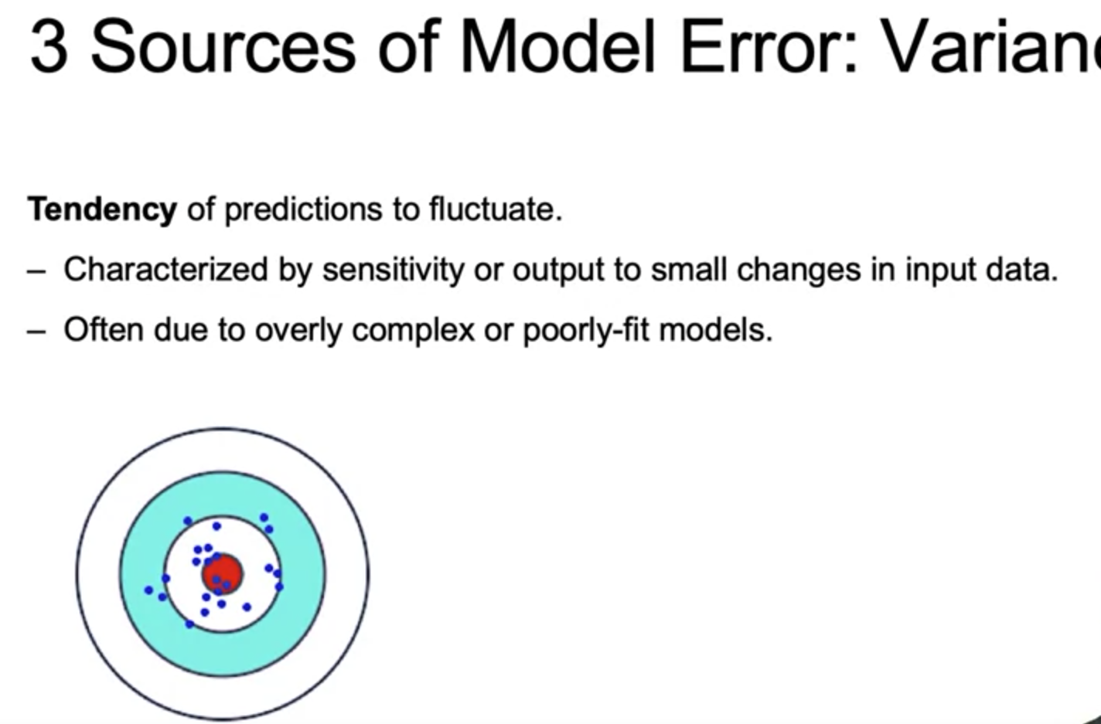
Bias Variance Trade off

Slide 10
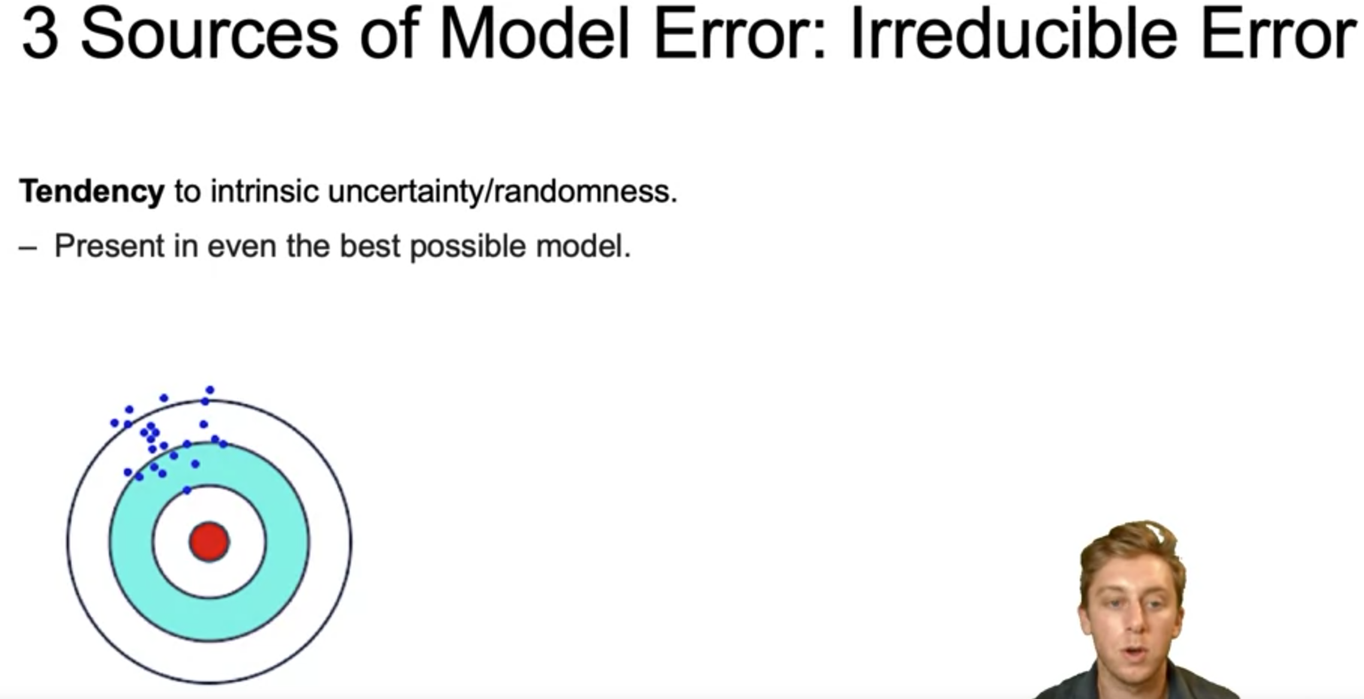
Bias Variance Trade off

Slide 11
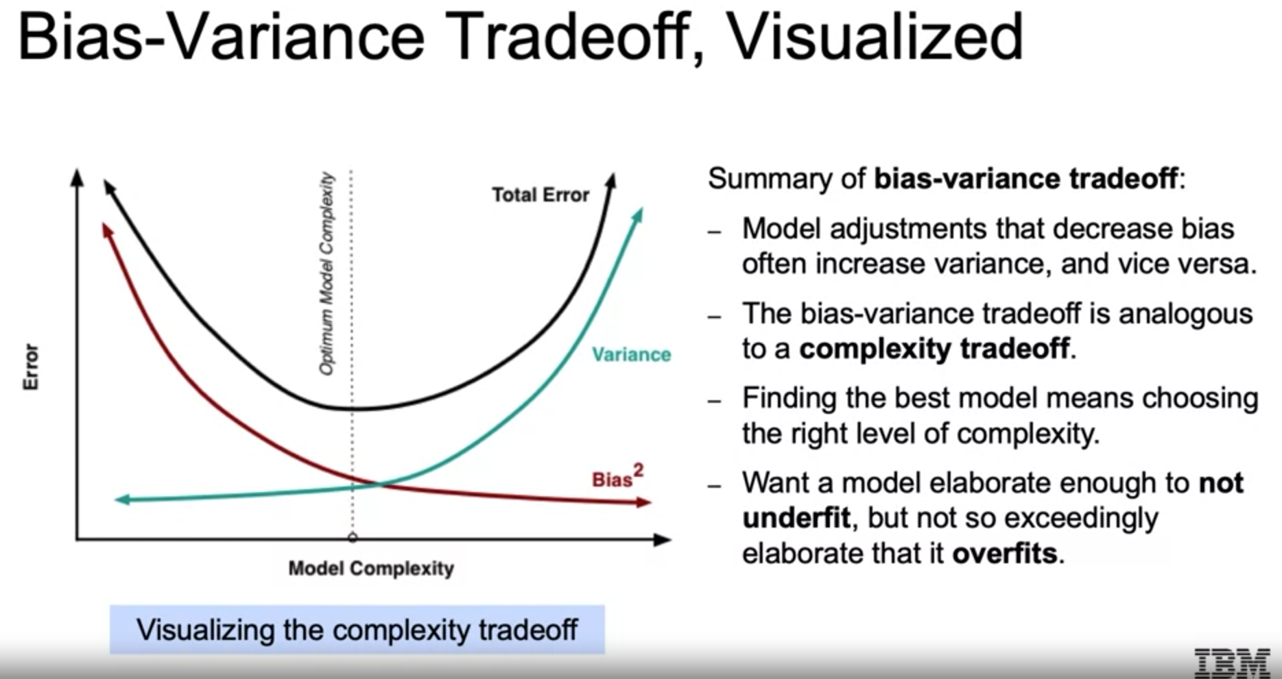
Bias Variance Trade off

Slide 12
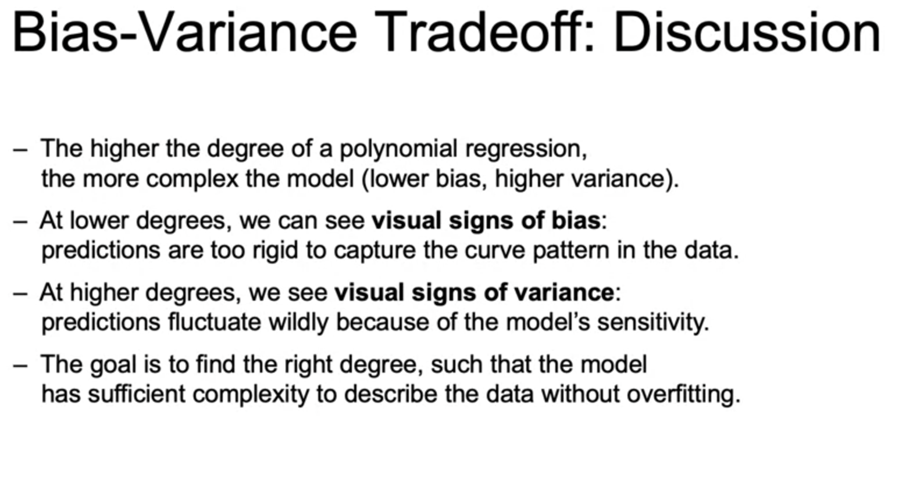
Bias Variance Trade off

Slide 13
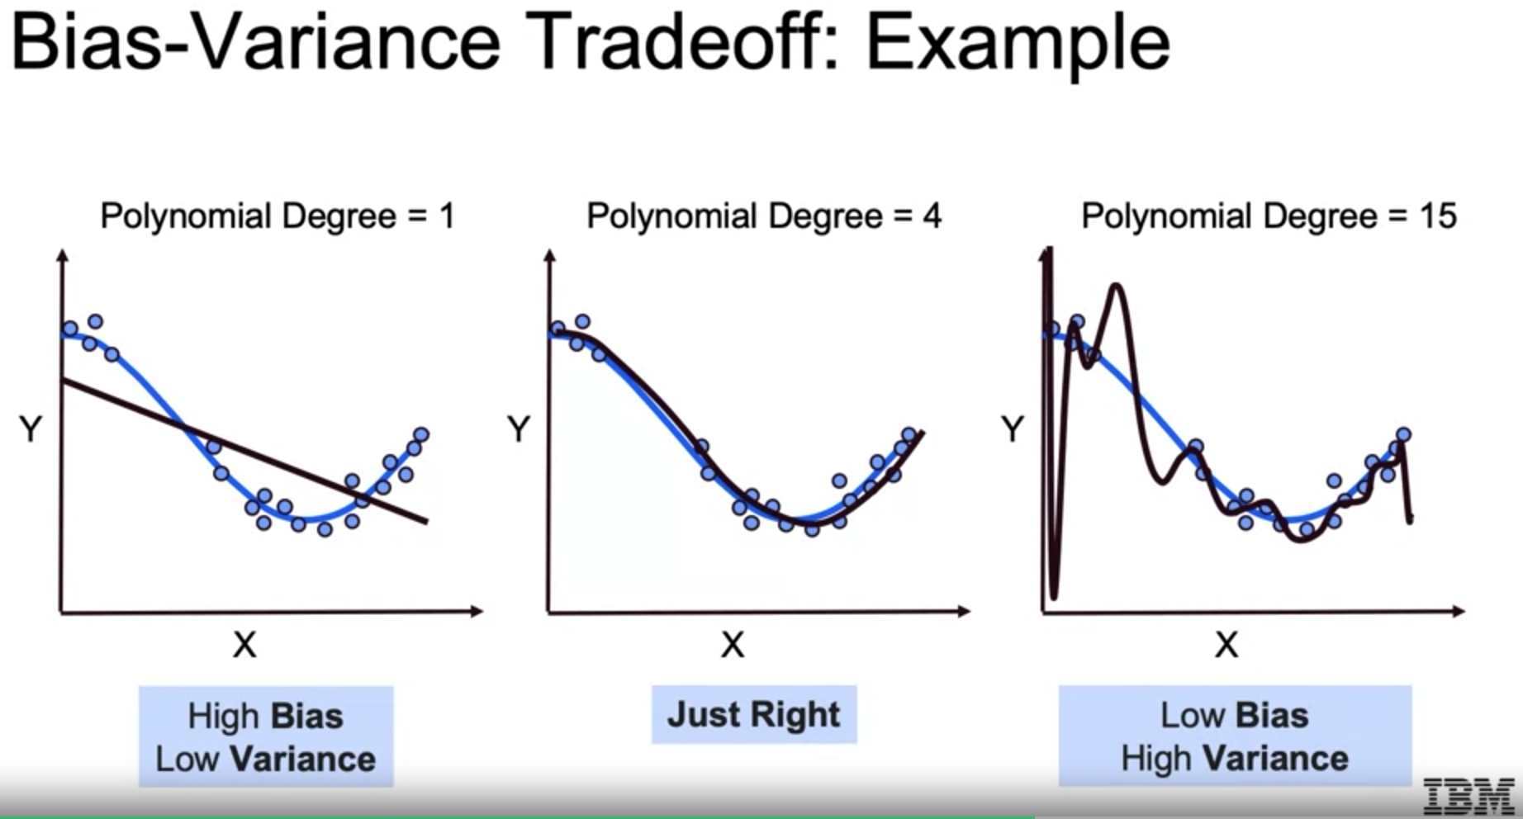
Bias Variance Trade off

Slide 14
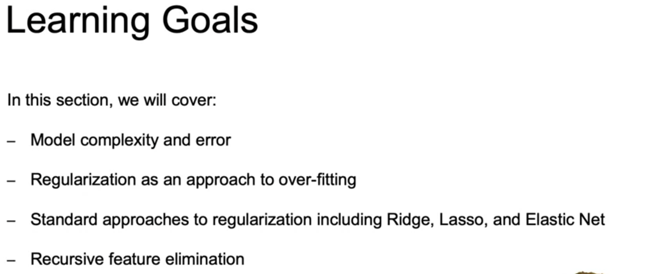
Regularization and Model Selection

Slide 15
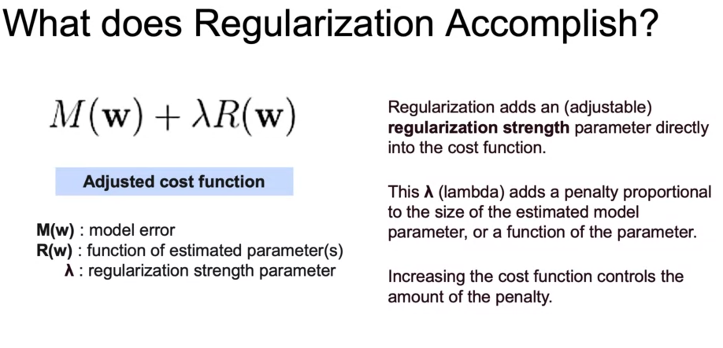
Regularization and Model Selection

Slide 16
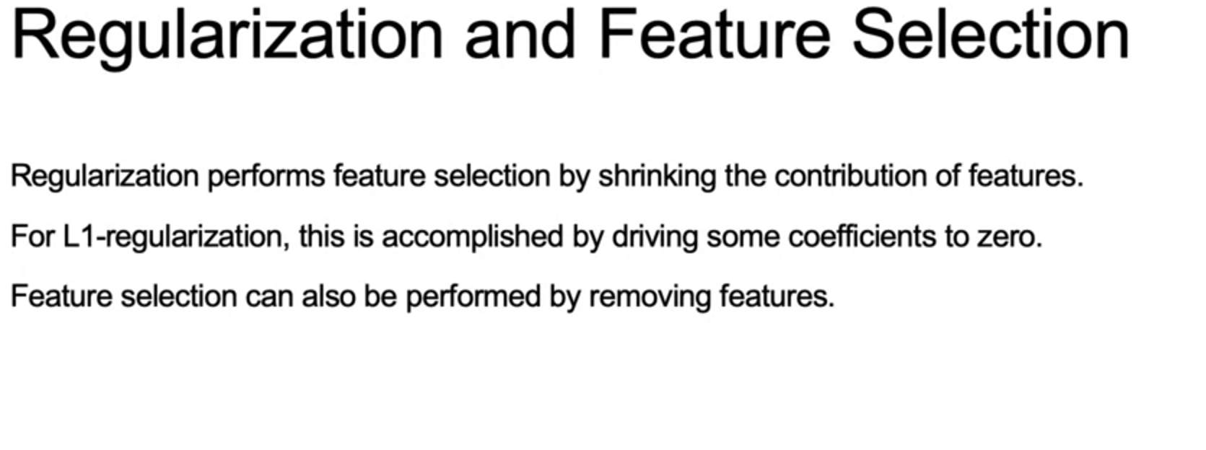
Regularization and Model Selection

Slide 17
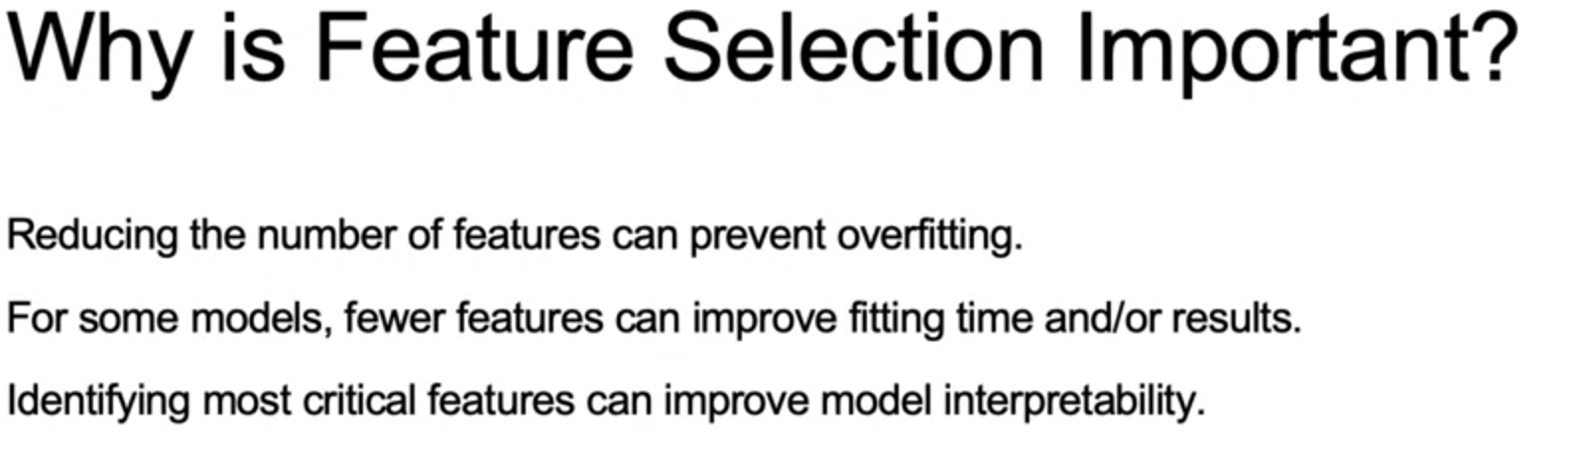
Regularization and Model Selection

Slide 18
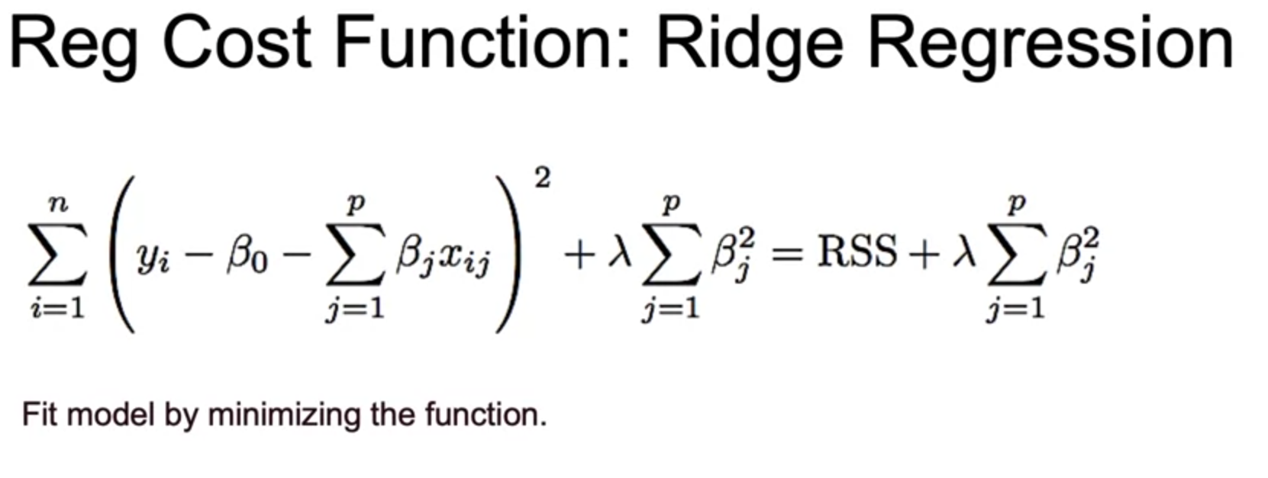
Ridge Regression

Slide 19
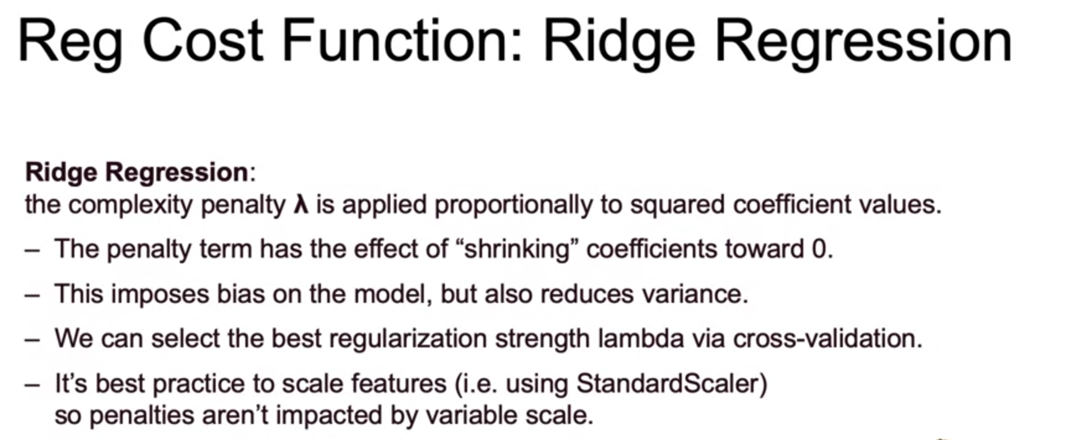
Ridge Regression

Slide 20
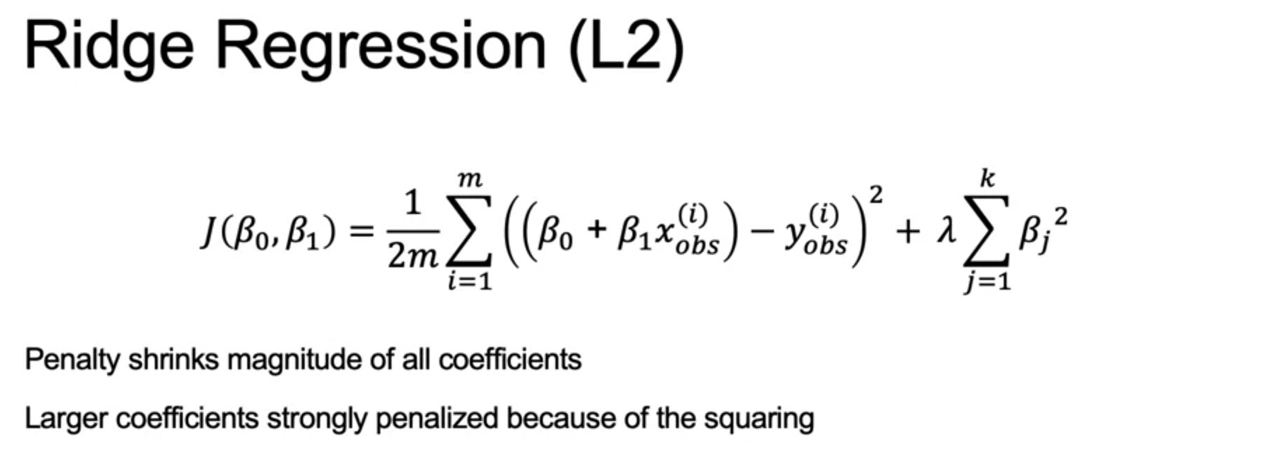
Ridge Regression

Slide 21
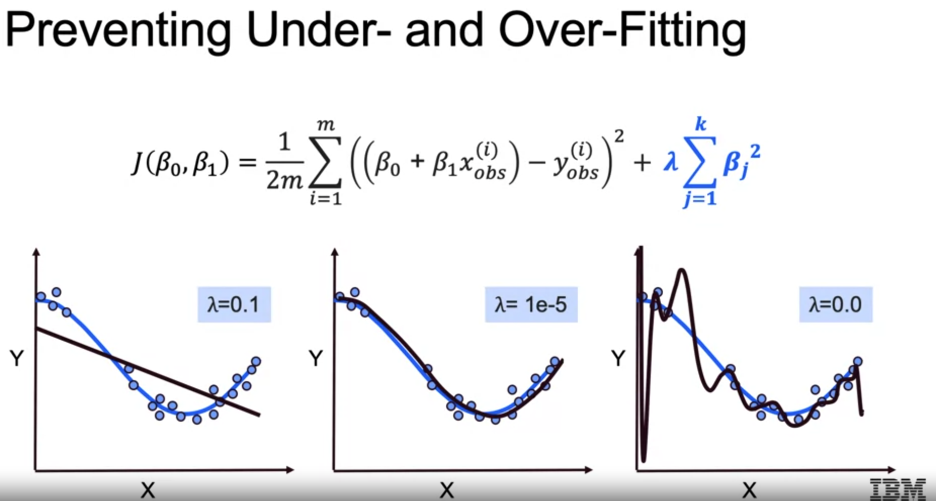
Ridge Regression

Slide 22
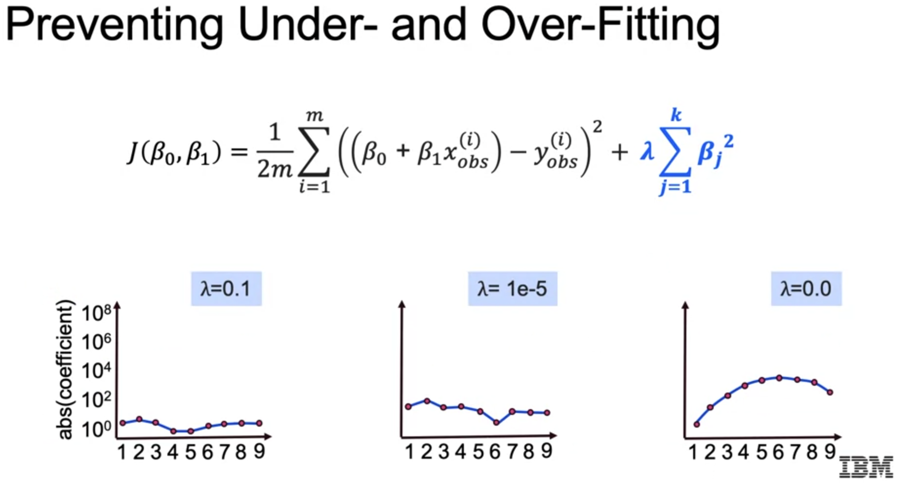
Ridge Regression

Slide 23
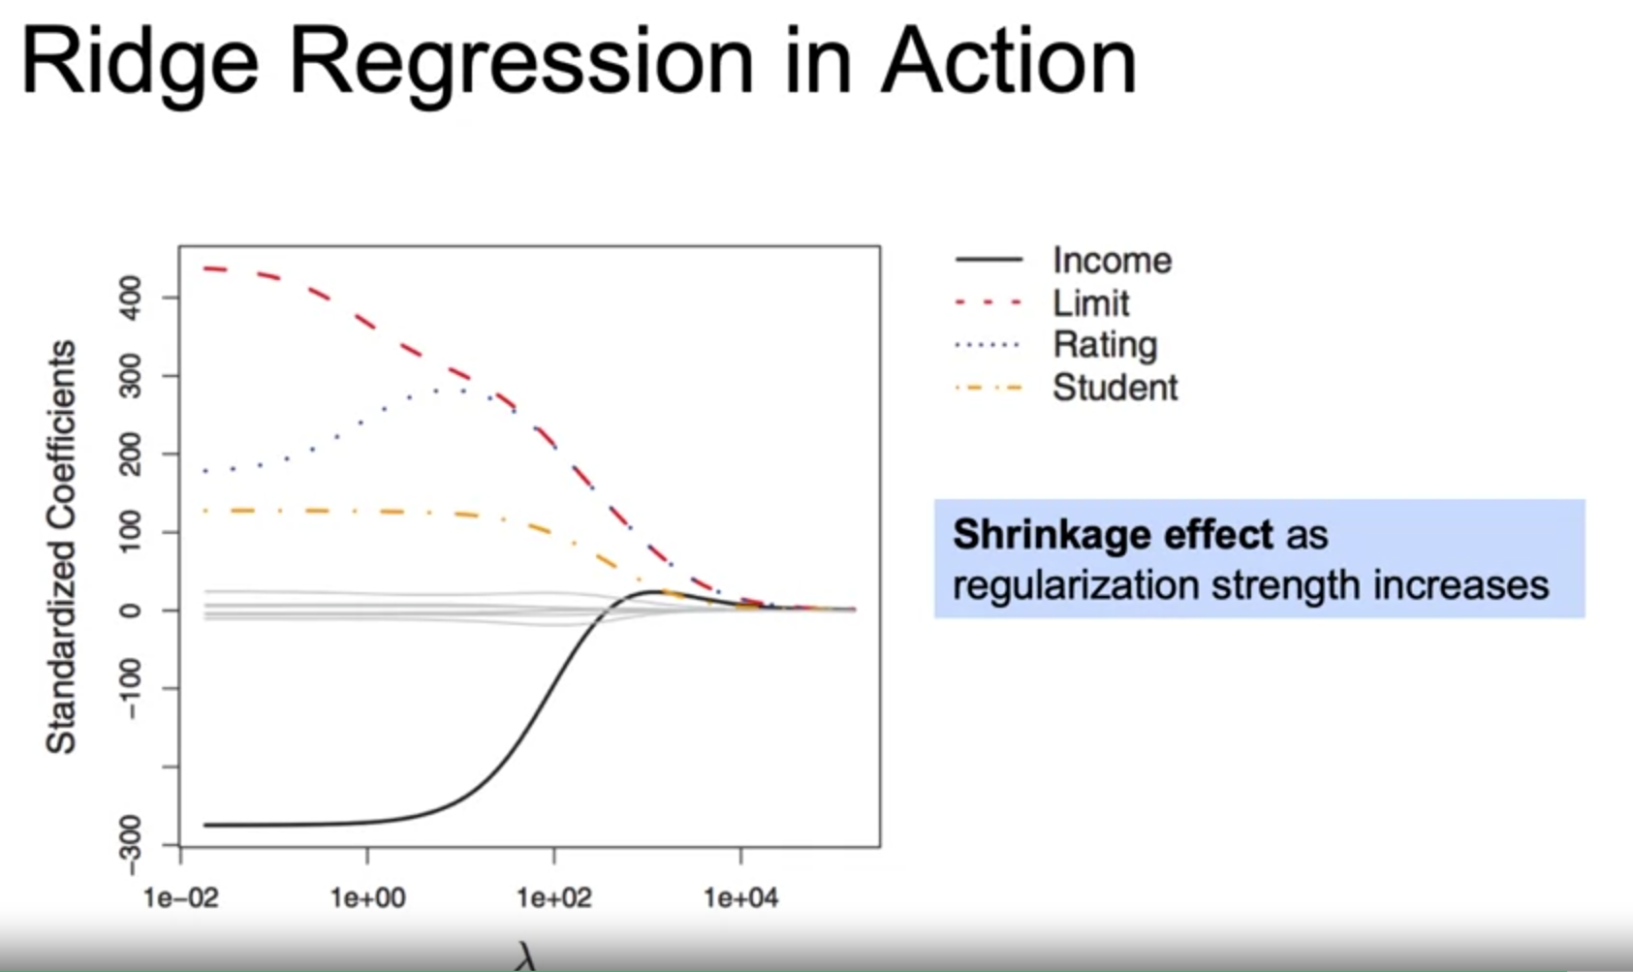
Ridge Regression

Slide 24
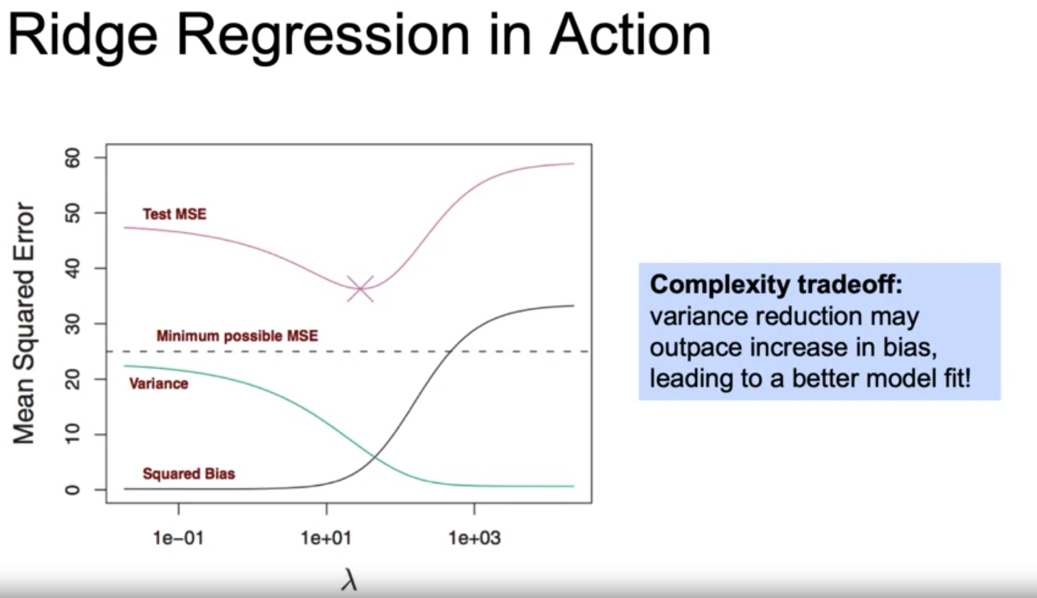
Ridge Regression

Slide 25
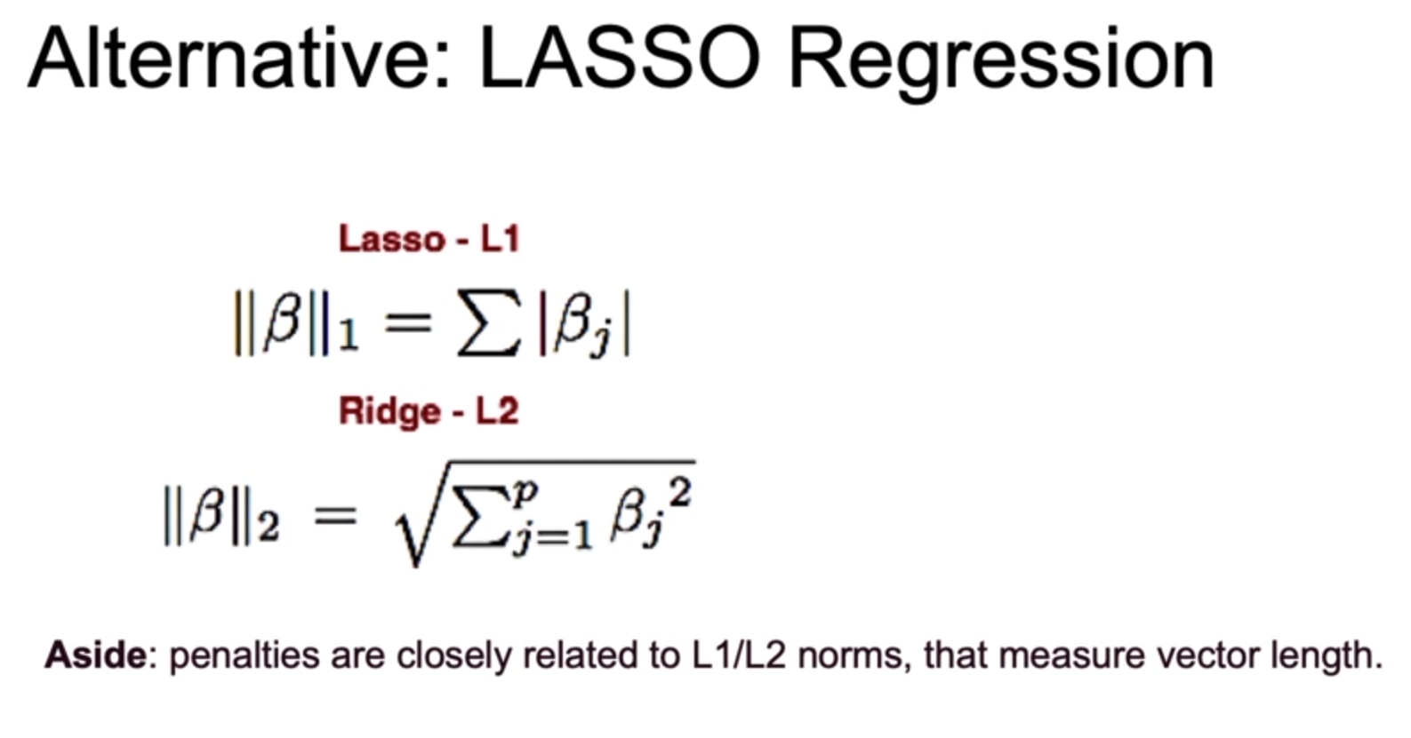
LASSO Regression

Slide 26
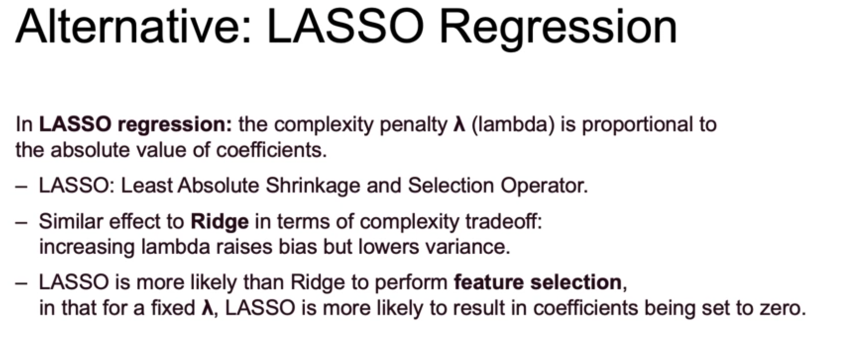
LASSO Regression

Slide 27
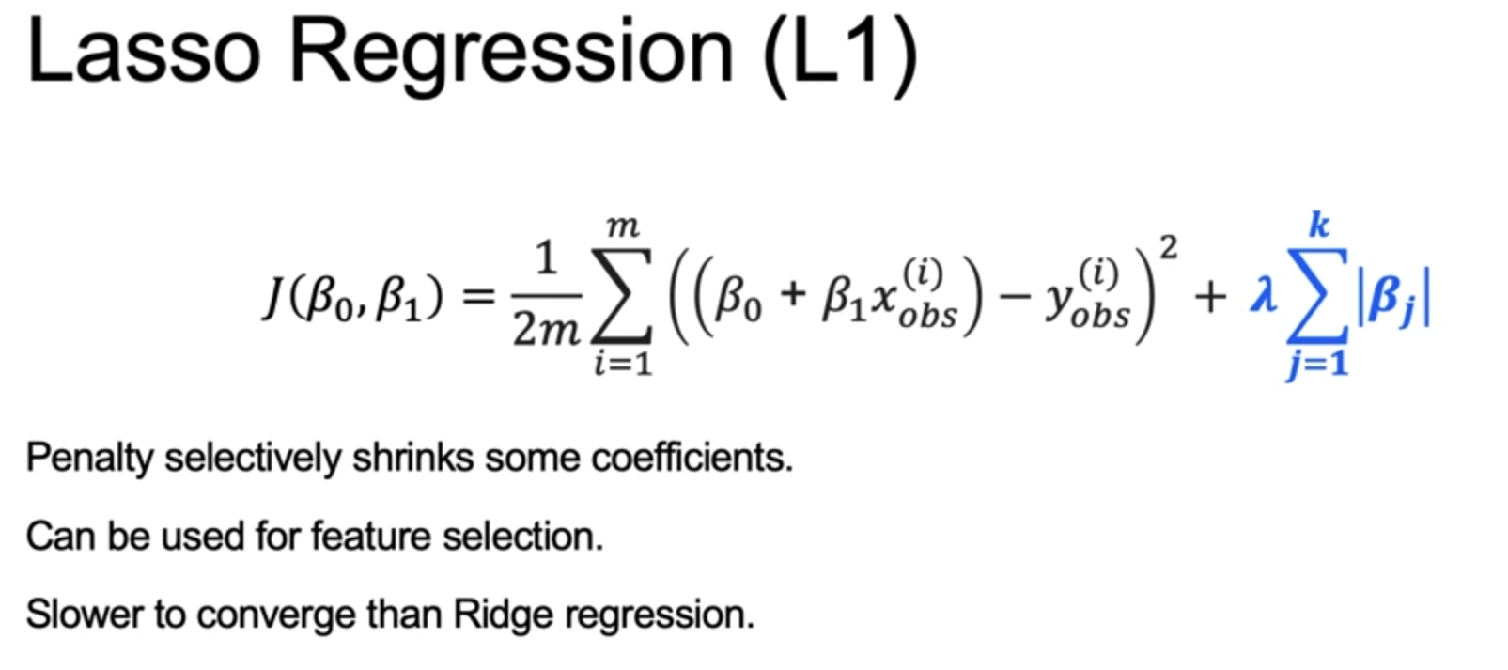
LASSO Regression

Slide 28
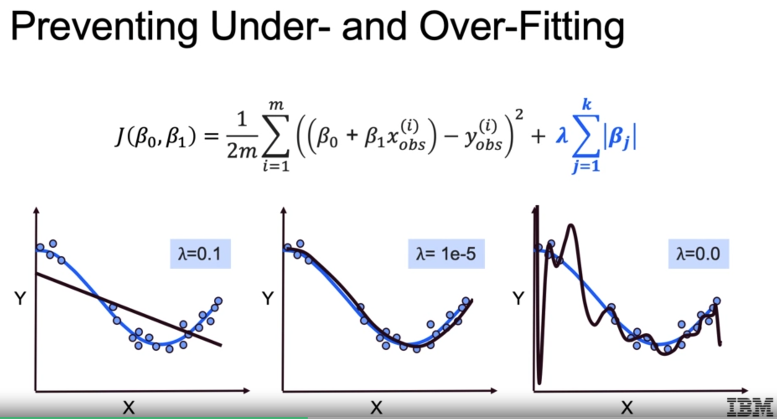
LASSO Regression

Slide 29
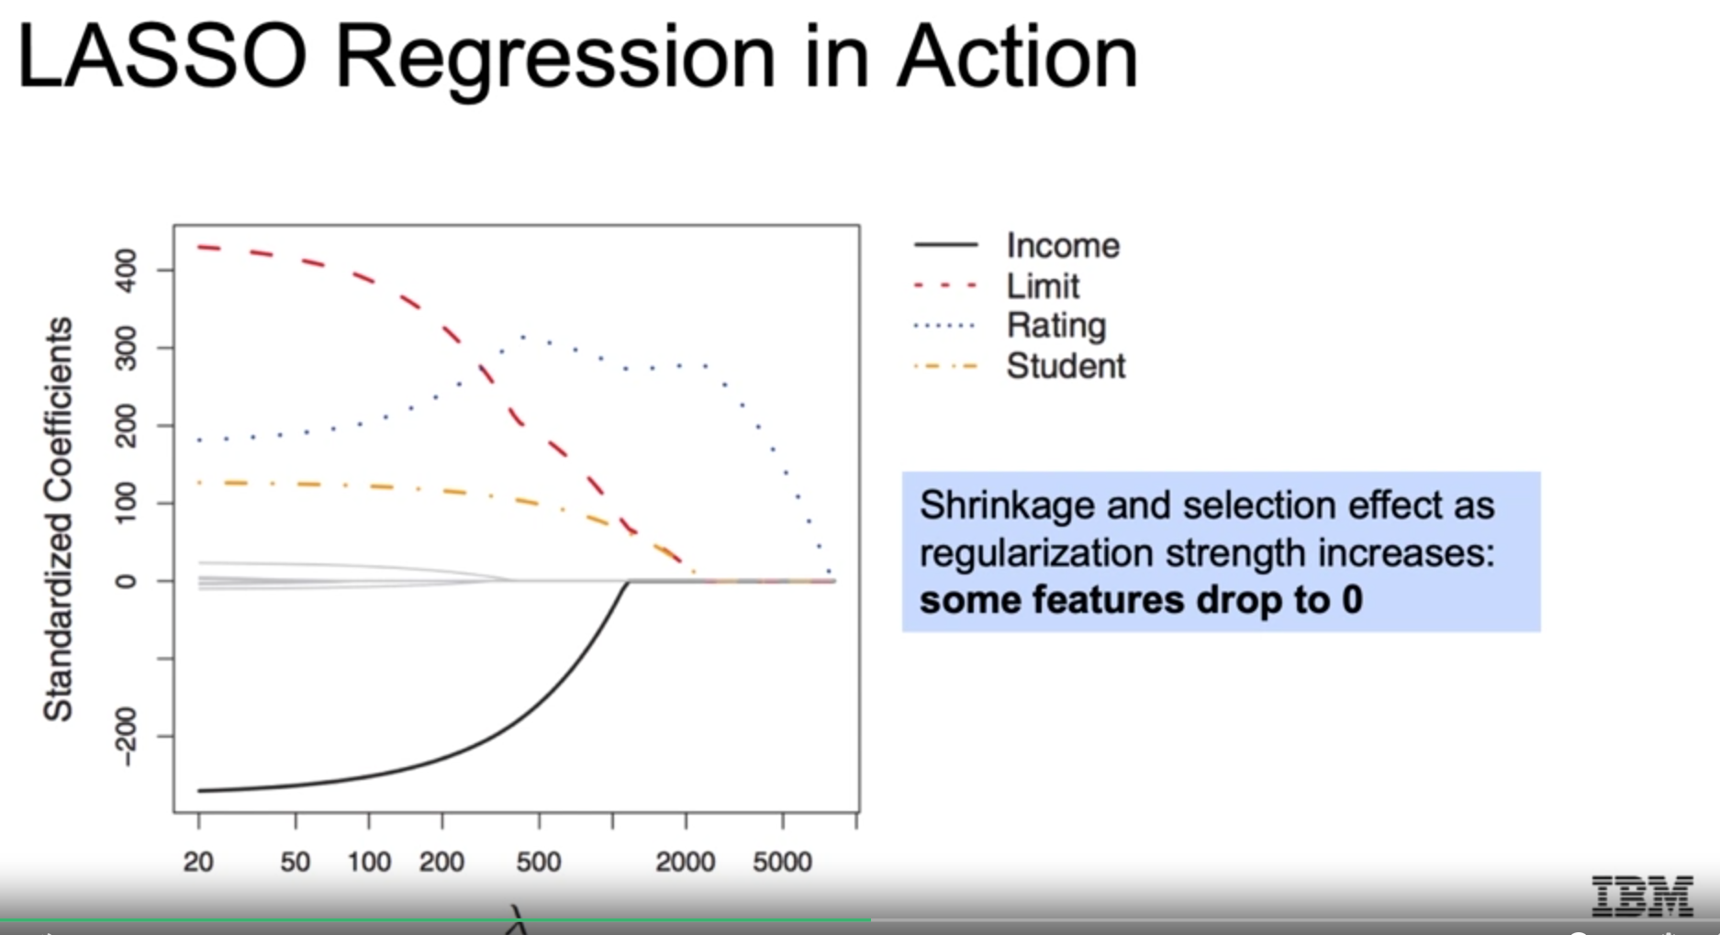
LASSO Regression

Slide 30
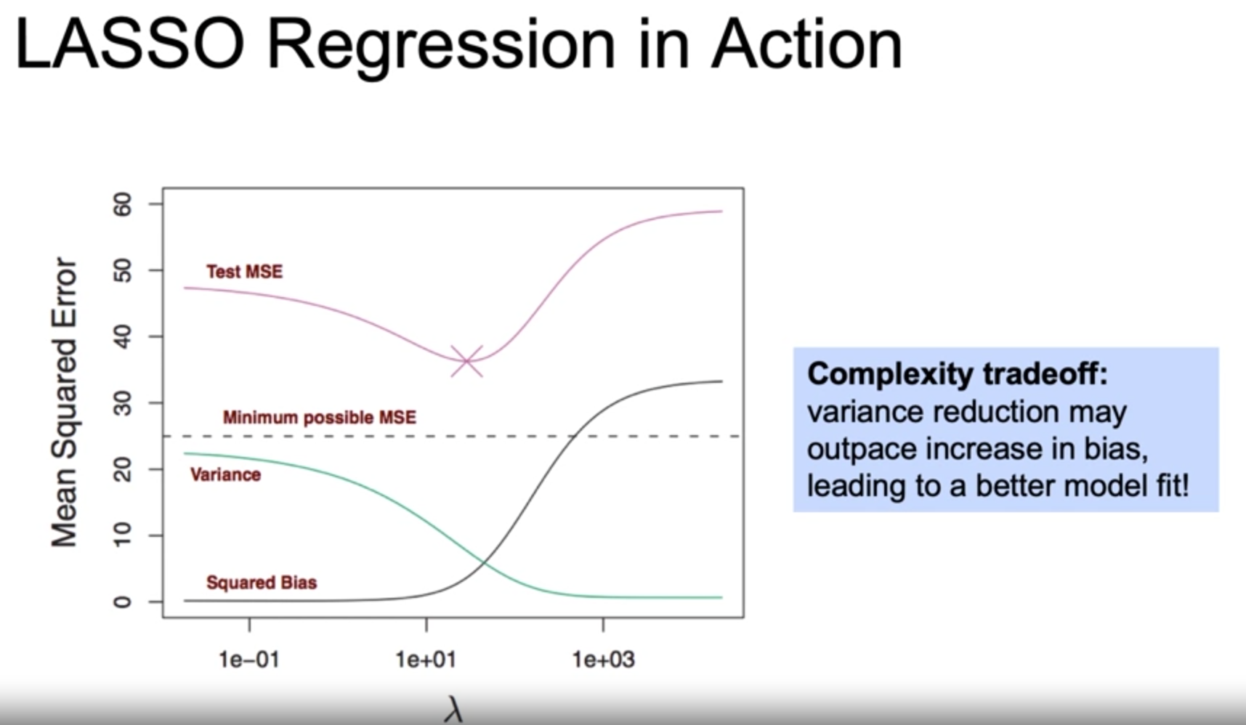
LASSO Regression

Slide 31
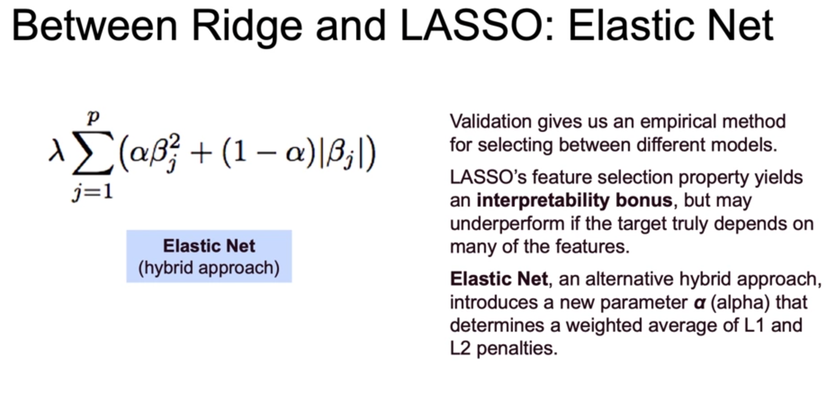
Between Ridge and LASSO: Elastic Net

Slide 32
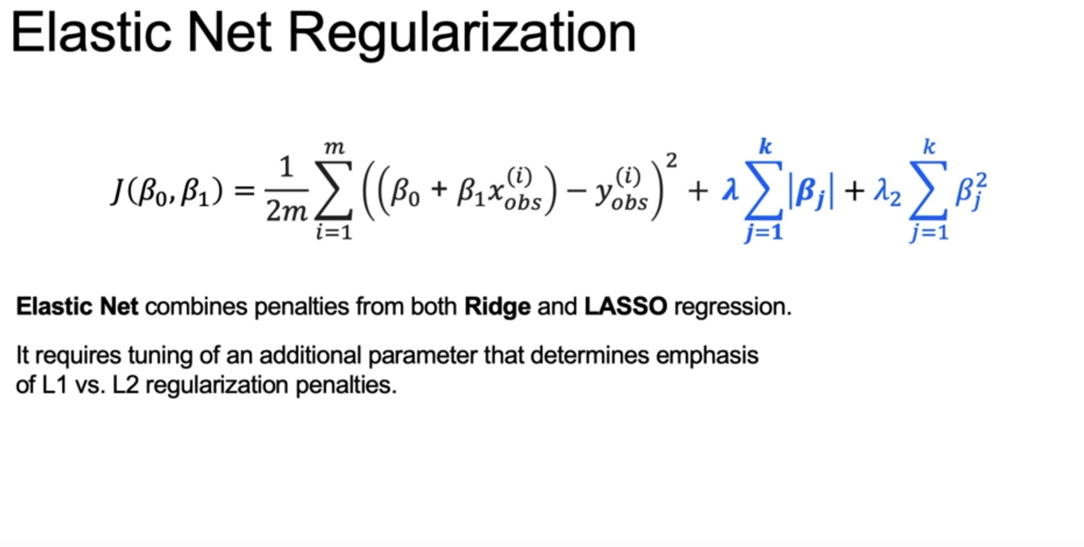
Between Ridge and LASSO: Elastic Net

Slide 33
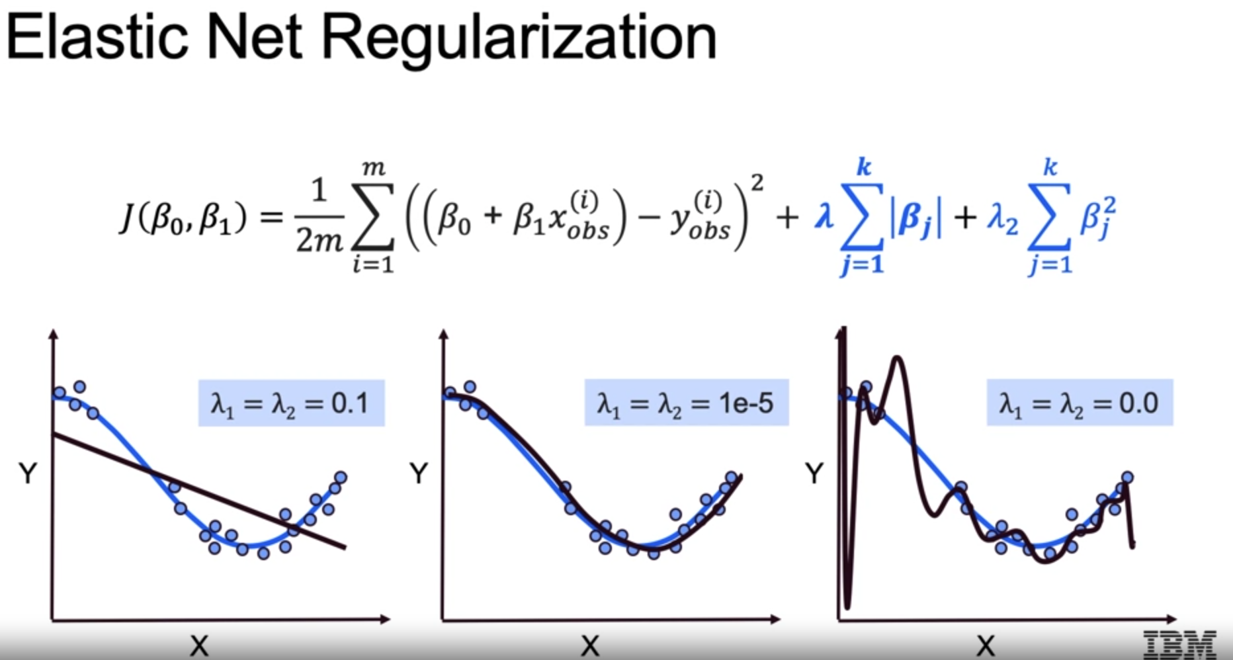
Between Ridge and LASSO: Elastic Net

Slide 34
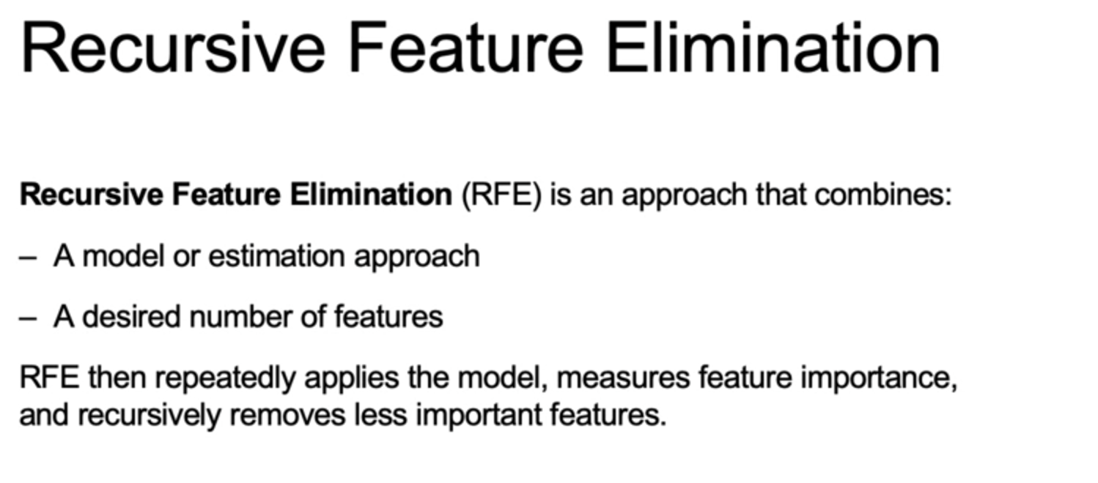
Recursive Feature Elimination

Slide 35
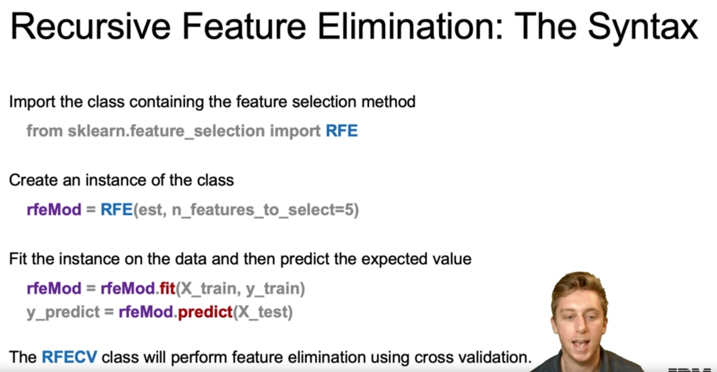
Recursive Feature Elimination

Slide 36
Regularization Summary
Summary/Review
Regularization Techniques
Three sources of error for your model are: bias, variance, and, irreducible error.
Regularization is a way to achieve building simple models with relatively low error. It helps you avoid overfitting by penalizing high-valued coefficients. It reduces parameters and shrinks the model.
Regularization adds an adjustable regularization strength parameter directly into the cost function.
Regularization performs feature selection by shrinking the contribution of features, which can prevent overfitting.
In Ridge Regression, the complexity penalty λ is applied proportionally to squared coefficient values.
– The penalty term has the effect of “shrinking” coefficients toward 0.
– This imposes bias on the model, but also reduces variance.
– We can select the best regularization strength lambda via cross-validation.
– It’s a best practice to scale features (i.e. using StandardScaler) so penalties aren’t impacted by variable scale.

Slide 37
Regularization Summary
In LASSO regression: the complexity penalty λ (lambda) is proportional to the absolute value of coefficients. LASSO stands for : Least Absolute Shrinkage and Selection Operator.
– Similar effect to Ridge in terms of complexity tradeoff: increasing lambda raises bias but lowers variance.
– LASSO is more likely than Ridge to perform feature selection, in that for a fixed λ, LASSO is more likely to result in coefficients being set to zero.
Elastic Net combines penalties from both Ridge and LASSO regression. It requires tuning of an additional parameter that determines emphasis of L1 vs. L2 regularization penalties.
LASSO’s feature selection property yields an interpretability advantage, but may underperform if the target truly depends on many of the features.
Elastic Net, an alternative hybrid approach, introduces a new parameter α (alpha) that determines a weighted average of L1 and L2 penalties.
Regularization techniques have an analytical, a geometric, and a probabilistic interpretation.

Slide 38
Final Project
Project Scenarios:
One of the main objectives of this course is to help you gain hands-on experience in communicating insightful and impactful findings to stakeholders. In this project, you will use the tools and techniques you learned throughout this course to train a few linear regressions model on a data set that you feel passionate about, select the regression that best suits your needs, and communicate insights you found from your modelling exercise.
After going through some guided steps, you will have insights that either explain or predict your outcome variable. As the main deliverable, you will submit a report that helps you focus on highlighting your analytical skills and thought process.
Your peer will review your report from the perspective of a Chief Data Officer or the Head of Analytics and will assess whether your final linear regression went through all the necessary steps to achieve the main objective of your analysis.
Before you begin, you will need to choose a data set that you feel passionate about. You can brainstorm with your peers about great public data sets using the discussion board in this module. Follow the instructions in the next section on how to complete and submit your notebook.

Slide 39
Final Project
Project Scenarios:
One of the main objectives of this course is to help you gain hands-on experience in communicating insightful and impactful findings to stakeholders. In this project, you will use the tools and techniques you learned throughout this course to train a few linear regressions model on a data set that you feel passionate about, select the regression that best suits your needs, and communicate insights you found from your modelling exercise.
After going through some guided steps, you will have insights that either explain or predict your outcome variable. As the main deliverable, you will submit a report that helps you focus on highlighting your analytical skills and thought process.
Your peer will review your report from the perspective of a Chief Data Officer or the Head of Analytics and will assess whether your final linear regression went through all the necessary steps to achieve the main objective of your analysis.
Before you begin, you will need to choose a data set that you feel passionate about. You can brainstorm with your peers about great public data sets using the discussion board in this module. Follow the instructions in the next section on how to complete and submit your notebook.

Slide 40
End

